Slide 1


College grades manager and speculator progressive web app
GradeCalc
https://gradecalc.app
2nd July, 2020
Author:
Director:
Maurici Abad Gutierrez
Cristina Gómez Seoane

Slide 2
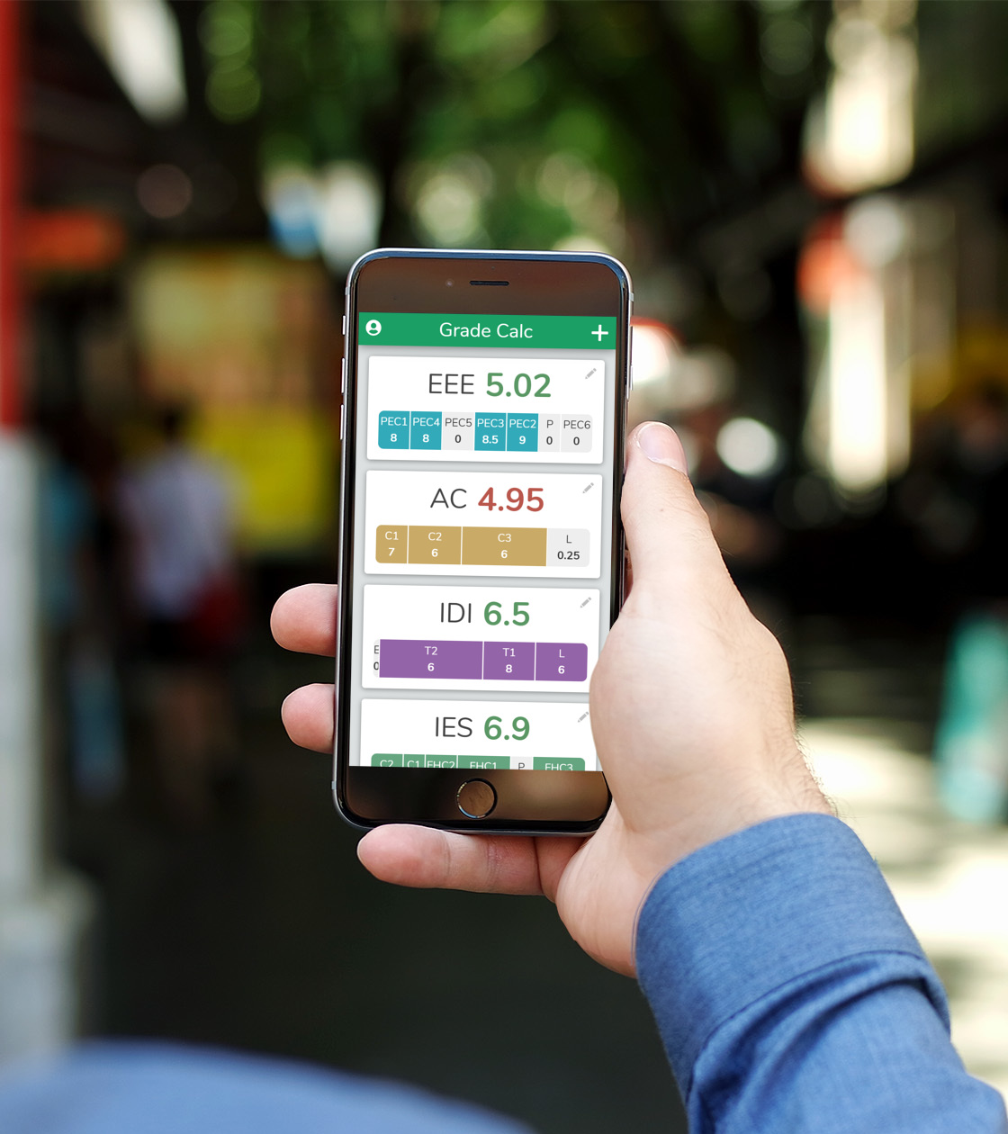
Overview
Introduction
Specification
Implementation
Evaluation
Conclusions
Demo

Slide 3
Contents
1 INTRODUCTION
1.1 The problem
1.2 The solutions
1.3 State of the Art
1.4 Stakeholders
2 PROJECT MANAGEMENT
2.1 Scope
2.2 Workflow
2.3 Schedule
2.4 Budget
2.5 Sustainability
2.6 Laws and regulations
3 REQUIREMENTS & SPECIFICATION
3.1 Functional requirements
3.2 Non-Functional requirements
3.3 Conceptual model
3.4 Tasks
4 SOFTWARE DESIGN
4.1 Software architecture
4.2 Presentation layer’s design
4.3 Domain layer’s design
4.4 Data layer’s design
5 IMPLEMENTATION
5.1 Tech stack
5.2 Brand identity
6 TESTING
6.1 Manual tests
6.2 Automated tests
6.3 Satisfaction survey
7 DEVOPS
7.1 Continuous integration
7.2 Continuous deployment
8 POST-DEVELOPMENT
8.1 Maintenance tasks
8.2 Web analytics
9 CONCLUSIONS
9.1 Encountered issues
9.2 Accomplished objectives
9.3 Technical competences
9.4 Integration of knowledge
9.5 Future improvements
9.6 Personal takeaways

Slide 4




INTRODUCTION
The problem
State of the art

Slide 5
The problem
Students need to know the necessary grade to pass.
Making speculations is complicated.
There is no easy method.
Students can’t organize their study time well.
The benefits of knowing the necessary grade to pass
Pass with minimum effort possible.
Focus on important assignments.
Decide what courses need more study time.
Less stress.
Is not the same to study a final needing a 4 than a 7.
Study harder if a high grade is needed.

Slide 6
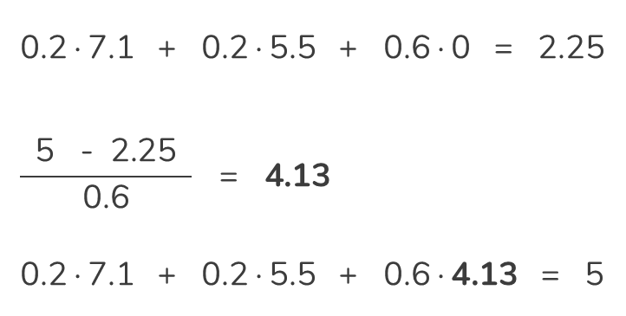
How to calculate the necessary grade?
Find the grade to get in all the remaining exams to make the final grade equal 5
$$\text{Necessary} \text{grade}\text{ =} \frac{\text{5 − }\text{Current} \text{final} \text{grade} }{ \text{Sum} \text{of} \text{weights} \text{of} \text{undone} \text{exams} }$$
0.2∙7.1 + 0.2∙5.5 + 0.6∙0 = 2.25
$$\frac{ \text{5 −} \text{2.25} }{\text{0.6}} \text{= } \text{4.13}$$
0.2∙7.1 + 0.2∙5.5 + 0.6∙4.13 = 5
Exam | Weight | Grade
Parcial 1 | 20% | 7.1
Parcial 2 | 20% | 5.5
Final | 60% | -

Slide 7








What do students do?
Save the grades in:
Notes app
Memory
Agenda
Paper
School portal
Spreadsheet
Speculate the necessary grades:
Phone calculator
Calculator
Spreadsheet

Slide 8
State of the art
Generic grade calculators
Atenea - UPC’s virtual campus
Spreadsheet document

Slide 9




SPECIFICATION
Requirements

Slide 10
Objectives
Add functionalities.
Migrate code to a JavaScript task runner or bundler.
Improve UI design.
Brand design.
Bug fixing.
Add tests to the code.
Implement Continuous Integration and Deployment.
Implement users accounts.

Slide 11
Functional requirements
Calculate needed grade
Calculate final grade
See current grades
Sign-up
Log-in & Log-out
Save grades in cloud
Save grades in device
Create subject
Edit subject
View subject
Delete subject
Search subjects
Multiple evaluations
Dashboard
Auto-evaluate
Auto-save
Auto-sync
Responsive UI
Use from browser
Lunch icon
Offline
SEO
Tutorial
Undo
Notifications
Accessible
Updates
Analytics
Open-source
Background activity
In Spanish
Legal page

Slide 12
Non-functional requirements
Reliable
Easy to use
Engaging
Cheap to produce

Slide 13




IMPLEMENTATION
Architecture
Database
Brand

Slide 14
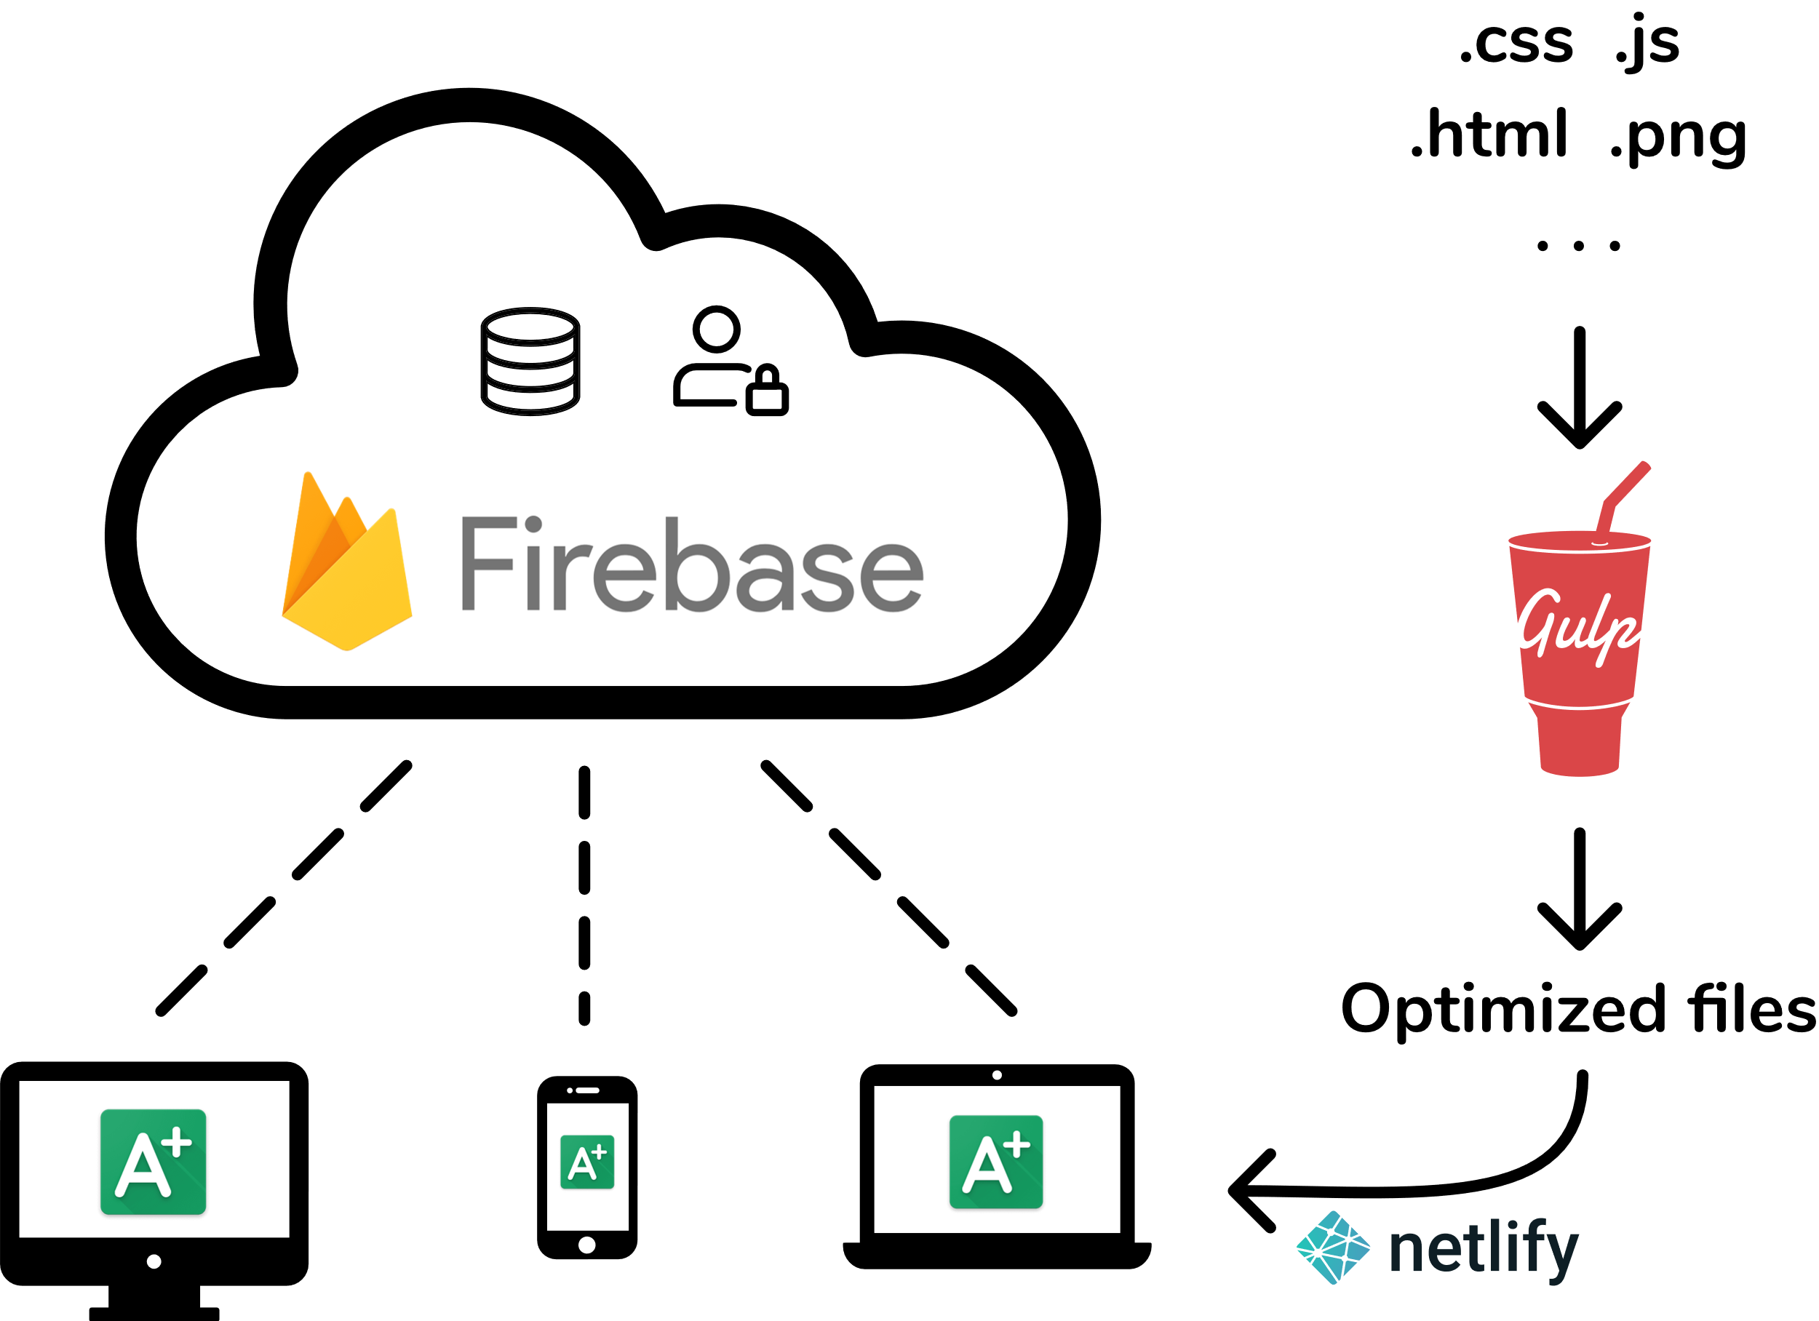
Architecture

Slide 15
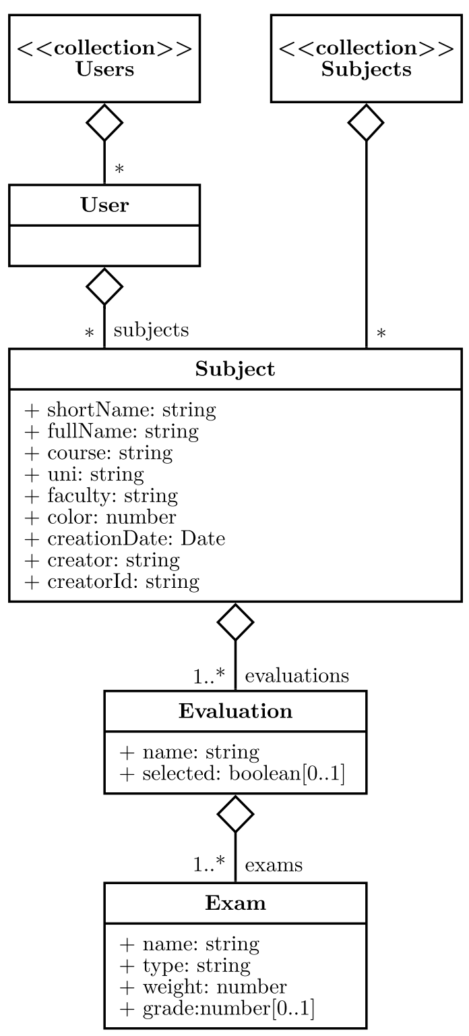
Database
{
shortName: "EDA",
fullName: "Estructures de Dades i Algorismes",
course: "Q2 2019-2020",
uni: "UPC",
faculty: "FIB",
color: 2,
evaluations: [
{
name: "Continua",
exams: [
{ name: "P1", weight: 0.3, type: "Exàmens", grade: 8.33 },
{ name: "PC", weight: 0.3, type: "Exàmens", grade: 5.5 }
{ name: "F", weight: 0.3, type: "Exàmens" },
{ name: "Joc", weight: 0.2, type: "Joc" }
]
}, {
name: "Final",
exams: [
{ name: "PC", weight: 0.3, type: "Exàmens“, grade: 5.5 },
{ name: "F", weight: 0.6, type: "Exàmens" },
{ name: "Joc", weight: 0.2, type: "Joc" }
]
}
],
creationDate: "February 28, 2020 at 9:39:50 PM UTC+1",
creator: "Maurici Abad Gutierrez",
creatorId: "4wUPZqVqt1Y9K6CAWLBNlZwe3b12"
}

Slide 16
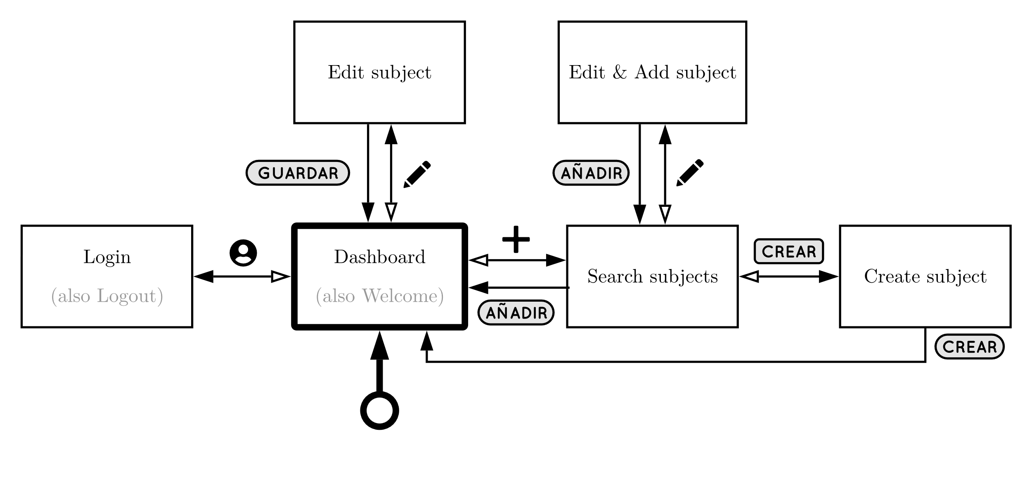
Navigational map
Minimum number of screens
Same appearence

Slide 17



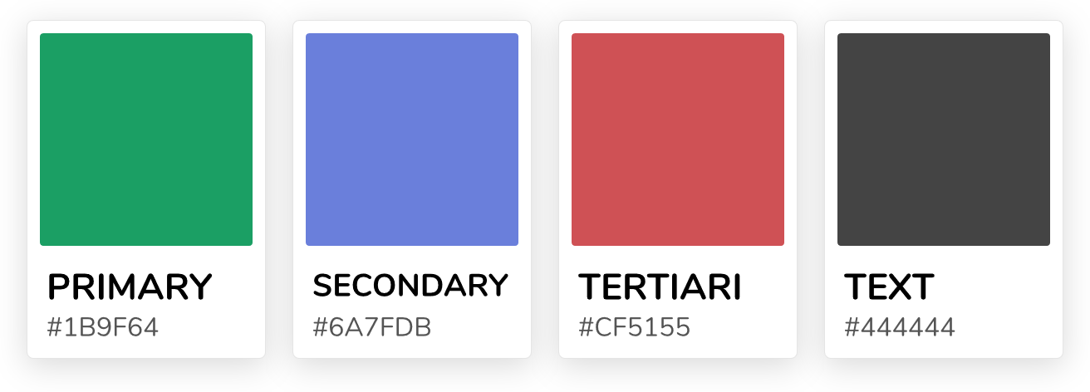

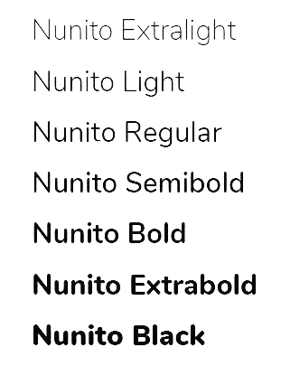
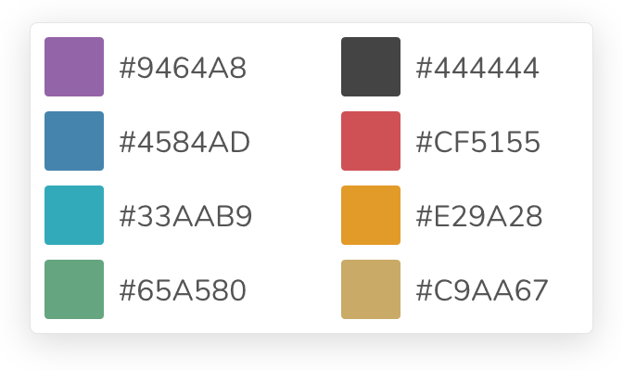
Brand identity
Logo
Colors
Font
Voice
Tetradic
combination
Friendly
Practical
Fresh
Nunito
The quick brown fox
Jumps over the lazy dog.

Slide 18




EVALUATION
Tests
DevOps
Survey

Slide 19
Tests
Manual tests
End to End tests
Automatic tests
Unitary tests
Account: Log-in / Log-out / Sign-in
Subjects: Search / Create / Edit / Delete
Edit grades
Offline
Necessary grade
Final grade
Edge cases
Negative values
Values greater than 10

Slide 20
Automatic tests subject
[
{
name: "E1 All same weights",
exams: [
{ name: "A1", weight: 0.25, type: "A" },
{ name: "A2", weight: 0.25, type: "A" },
{ name: "A3", weight: 0.25, type: "A" },
{ name: "A4", weight: 0.25, type: "A" }
]
},{
name: "E2 All different weights",
exams: [
{ name: "B1", weight: 0.2, type: "B" },
{ name: "B2", weight: 0.3, type: "B" },
{ name: "B3", weight: 0.5, type: "B" }
]
},{
name: "E3 Some same and different weights",
exams: [
{ name: "C1", weight: 0.1, type: "C" },
{ name: "C2", weight: 0.1, type: "C" },
{ name: "C3", weight: 0.8, type: "C" }
]
},{
name: "E4 Repeated exam names",
exams: [
{ name: "C1", weight: 0.5, type: "C" },
{ name: "C2", weight: 0.5, type: "C" }
]
},{
name: "E5 Weight's sum greater than 1",
exams: [
{ name: "D1", weight: 1, type: "D" },
{ name: "D2", weight: 1, type: "D" }
]
}
]

Slide 21
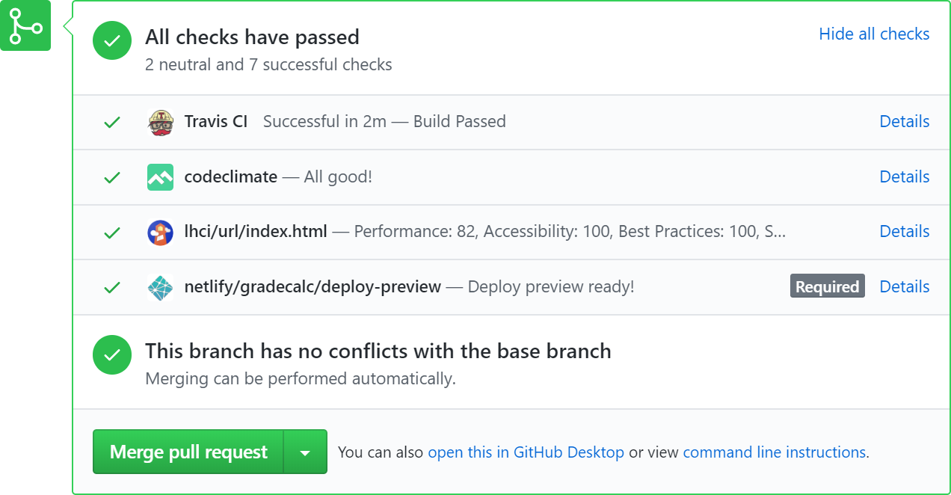
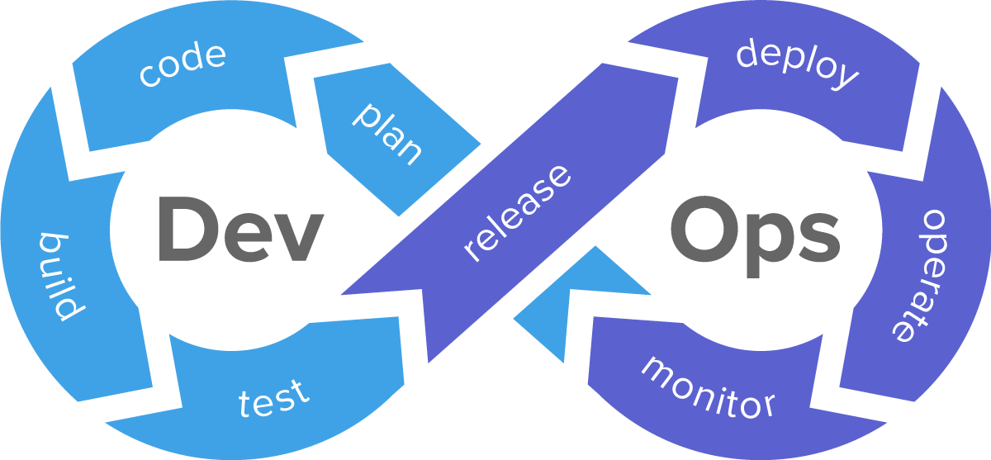
DevOps
Continuous Integration
Continuous Deployment
Automatic tests
Lighthouse audits
Static code analysis
Deploy previews
Deploys master automatically

Slide 22
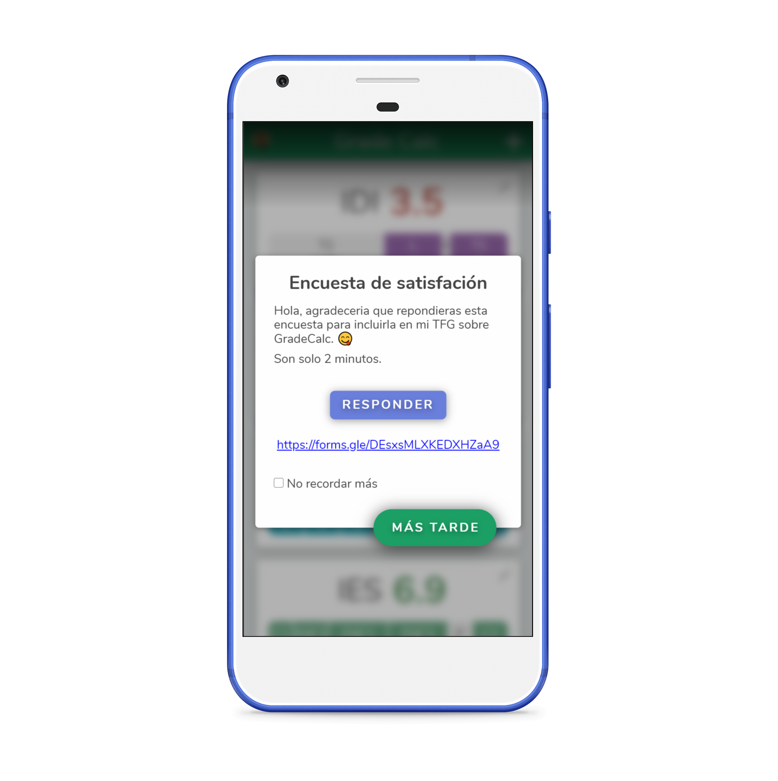
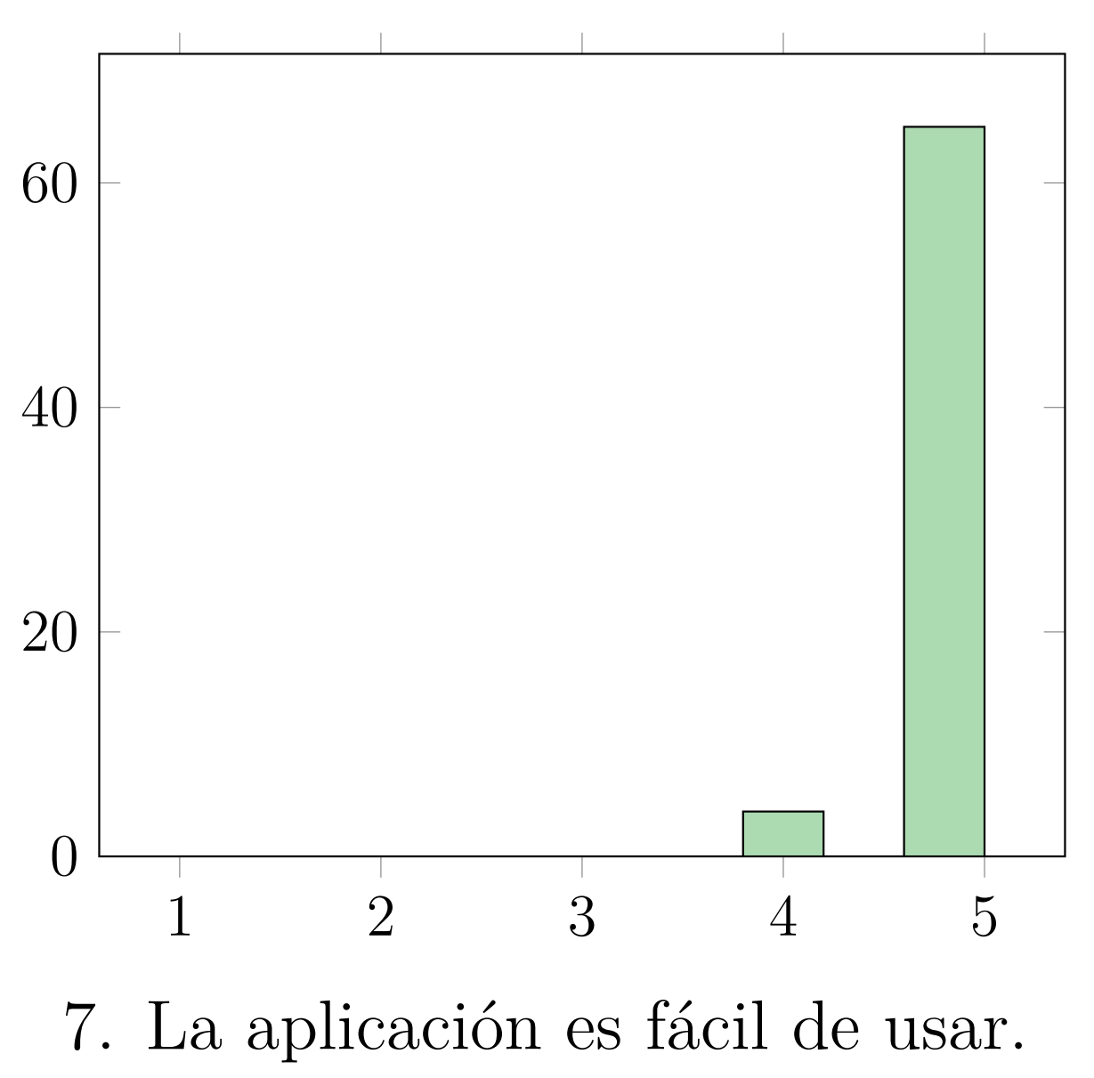
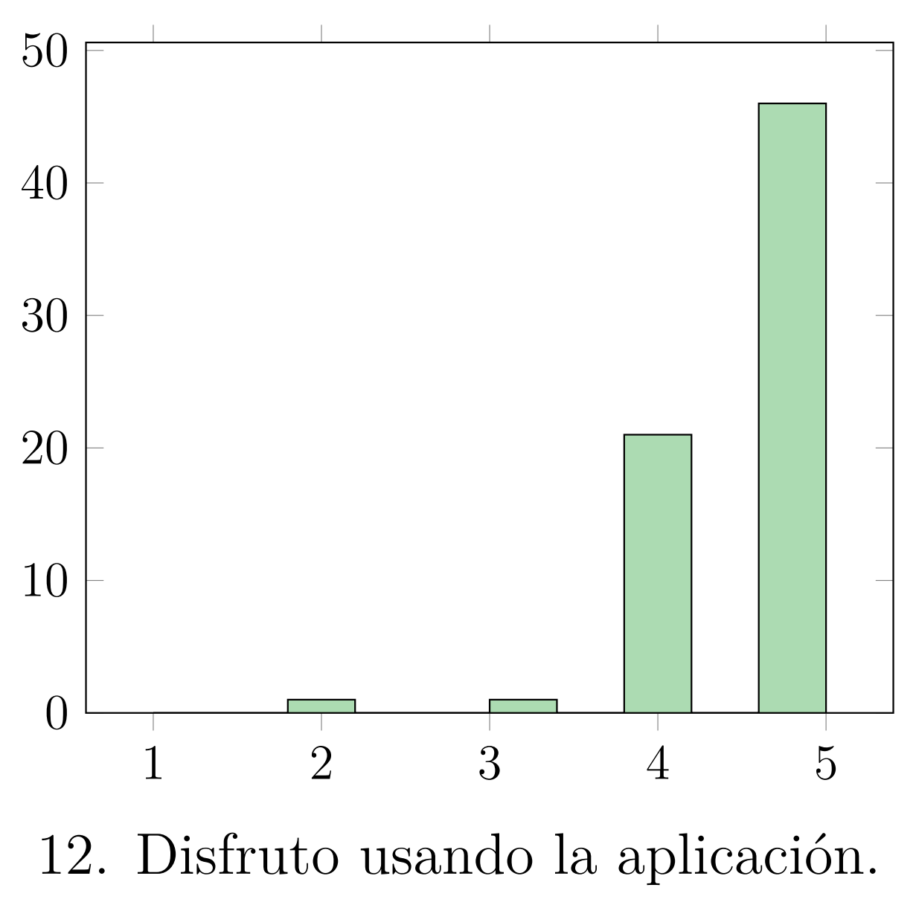
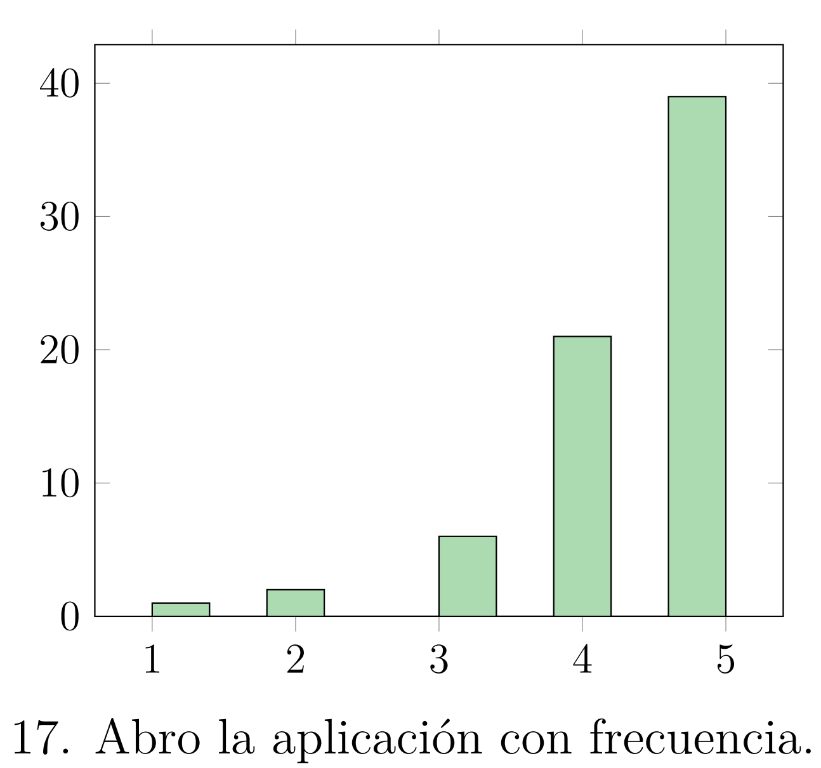
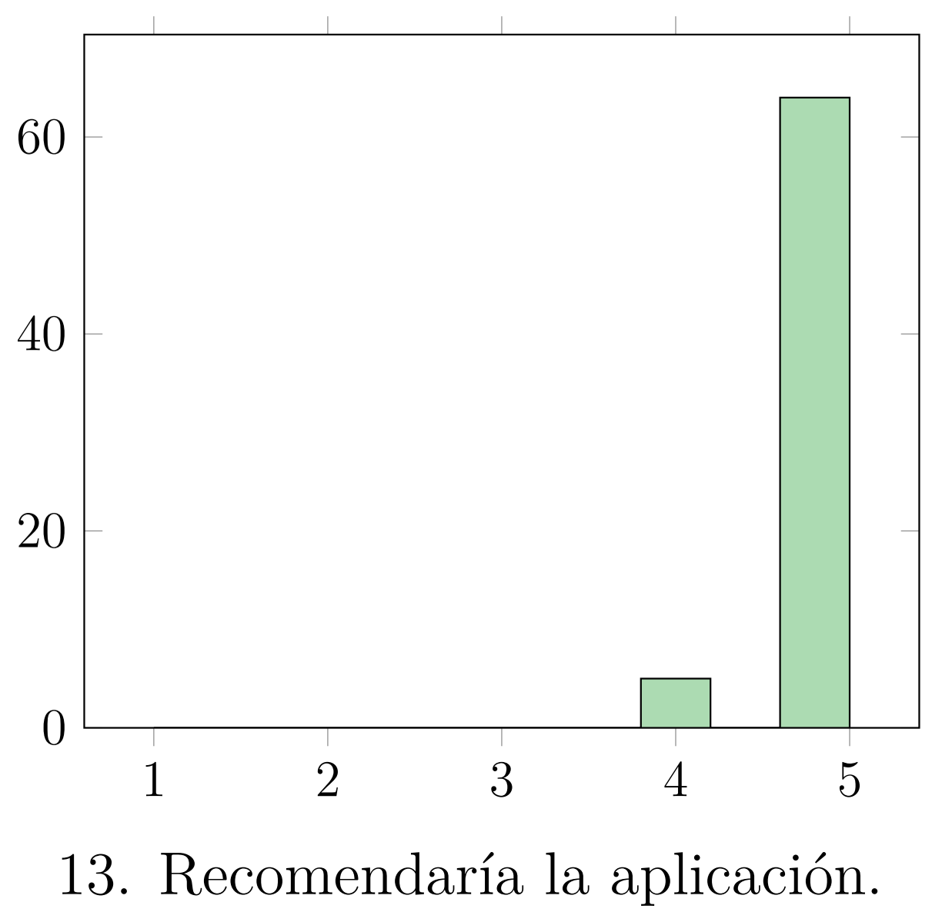
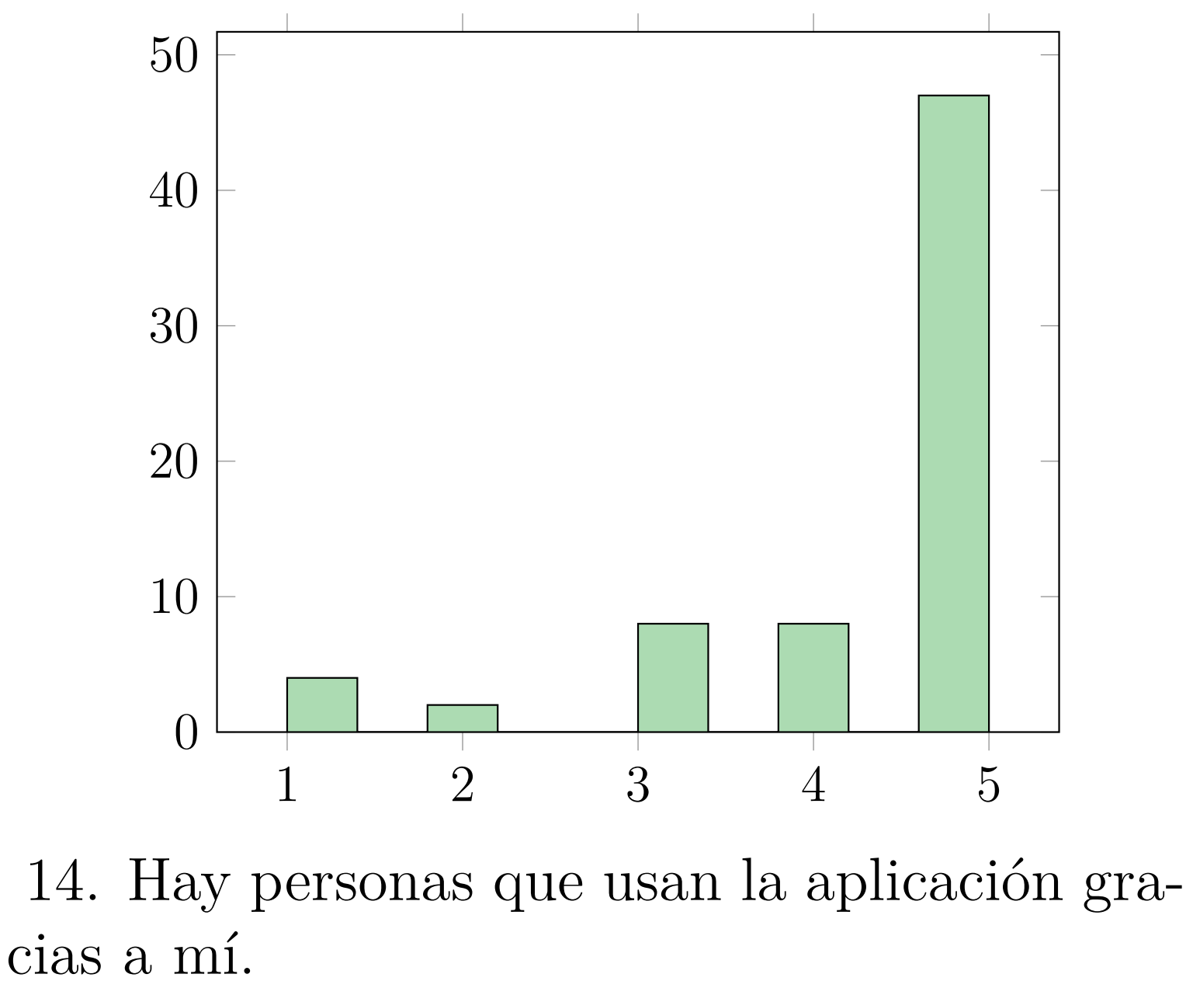
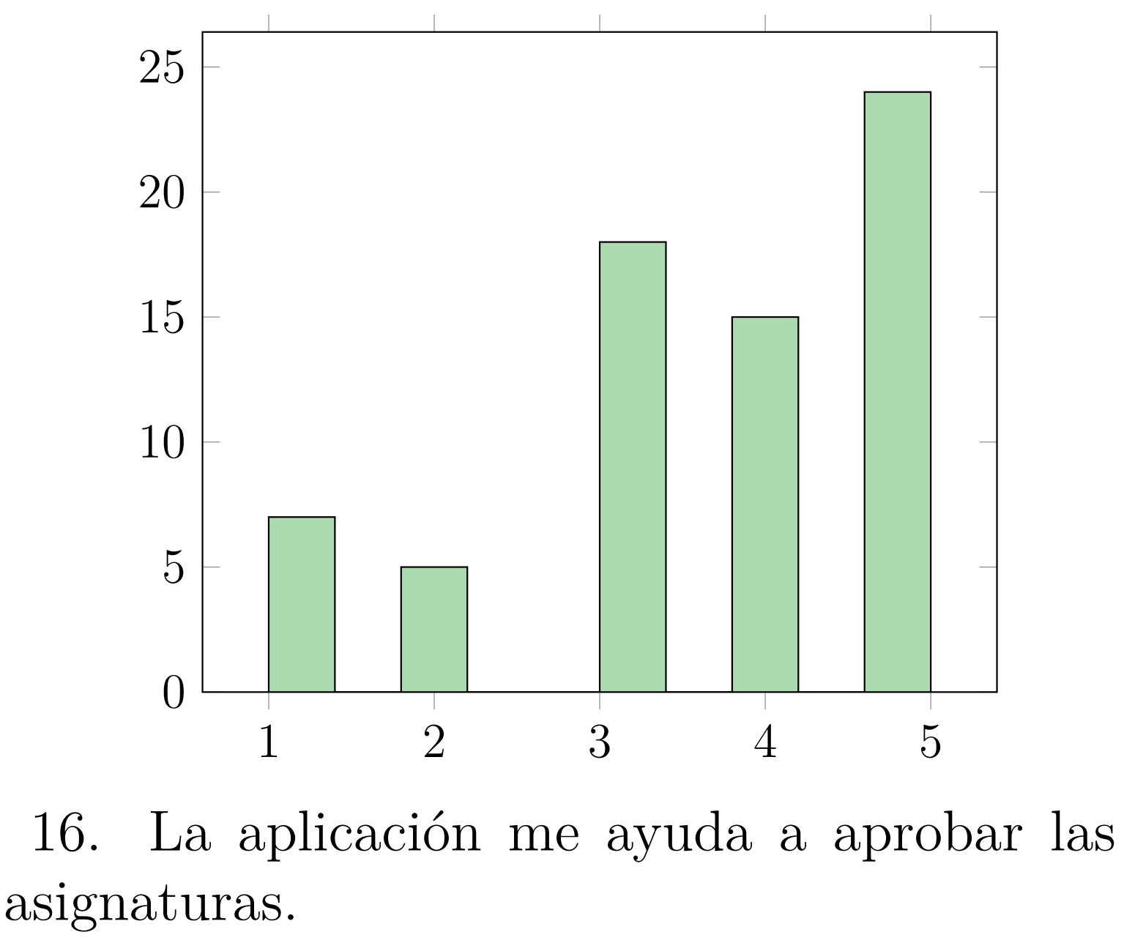
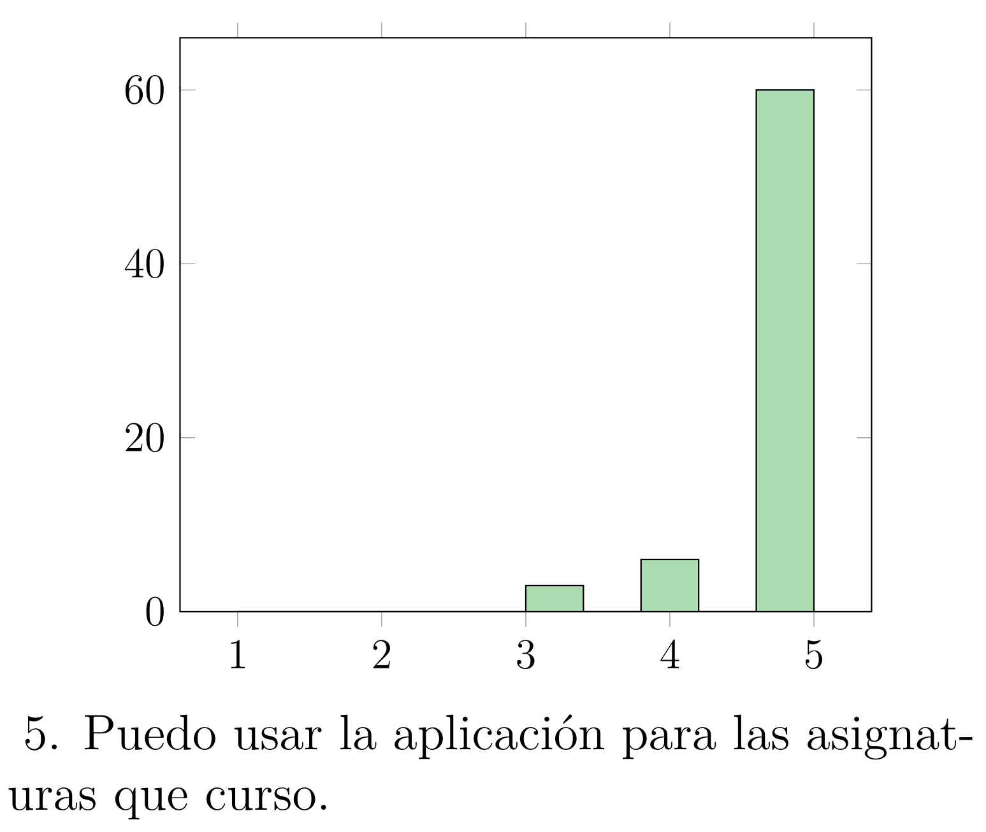
Satisfaction survey
70 participants in 4 days (26.4% of participation)

Slide 23




POST-DEVELOPMENT
Maintinance
Web performance

Slide 24
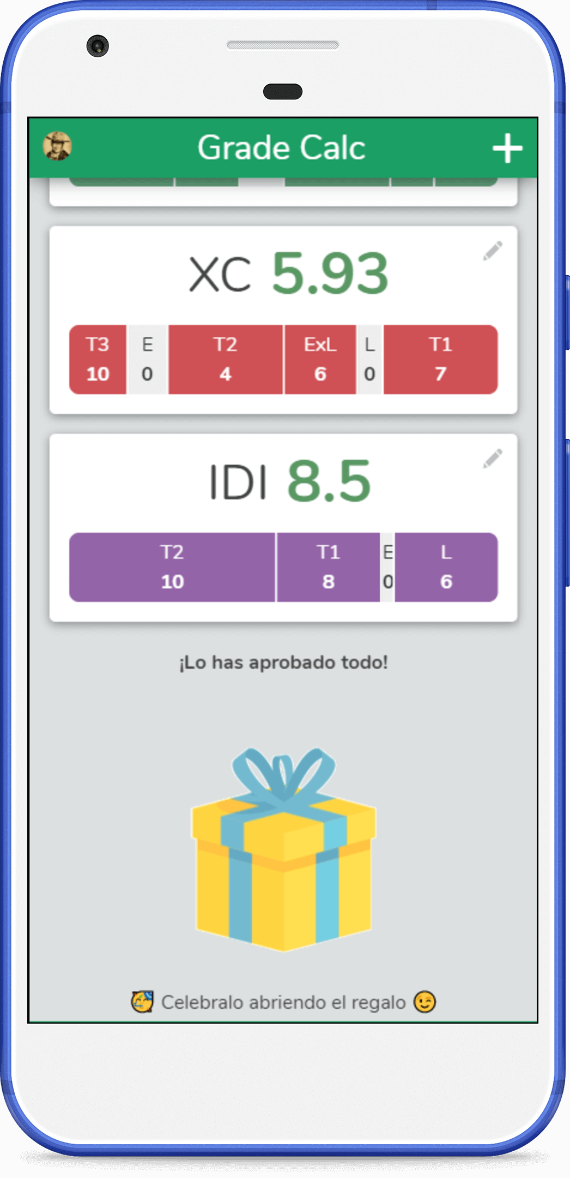
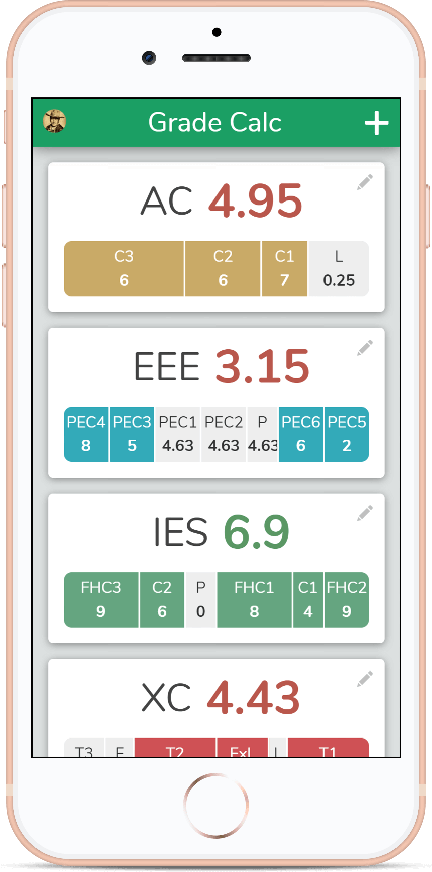
DEMO TIME
https://gradecalc.app

Slide 25




CONCLUSIONS
Future work
Conclusion

Slide 26
Future work
Monetize the app.
Complex evaluation formulas.
Find a system to avoid duplicate subjects.
Improve the dashboard.
Fix all the known bugs.

Slide 27
Conclusions
GradeCalc fulfills the requirements.
Project objectives achieved successfully.
I learned a lot.
The app is published.
FIB Students use and love the app.

Slide 28




THANK YOU
Have a nice summer!

Slide 29
College grades manager and speculator progressive web app
GradeCalc
https://gradecalc.app
2nd July, 2020
Author:
Director:
Maurici Abad Gutierrez
Cristina Gómez Seoane

Slide 30
APPENDIX

Slide 31
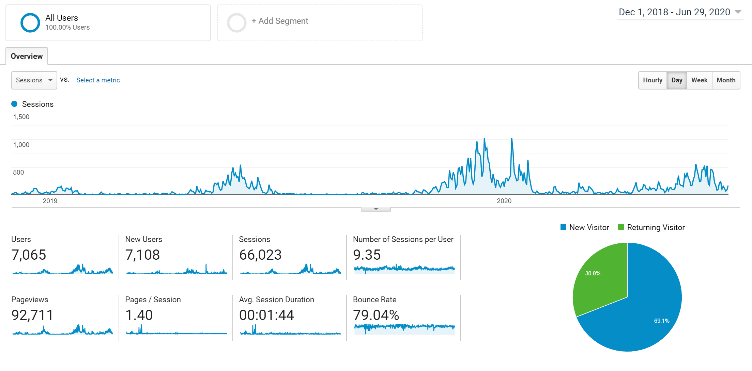
Web performance 1

Slide 32
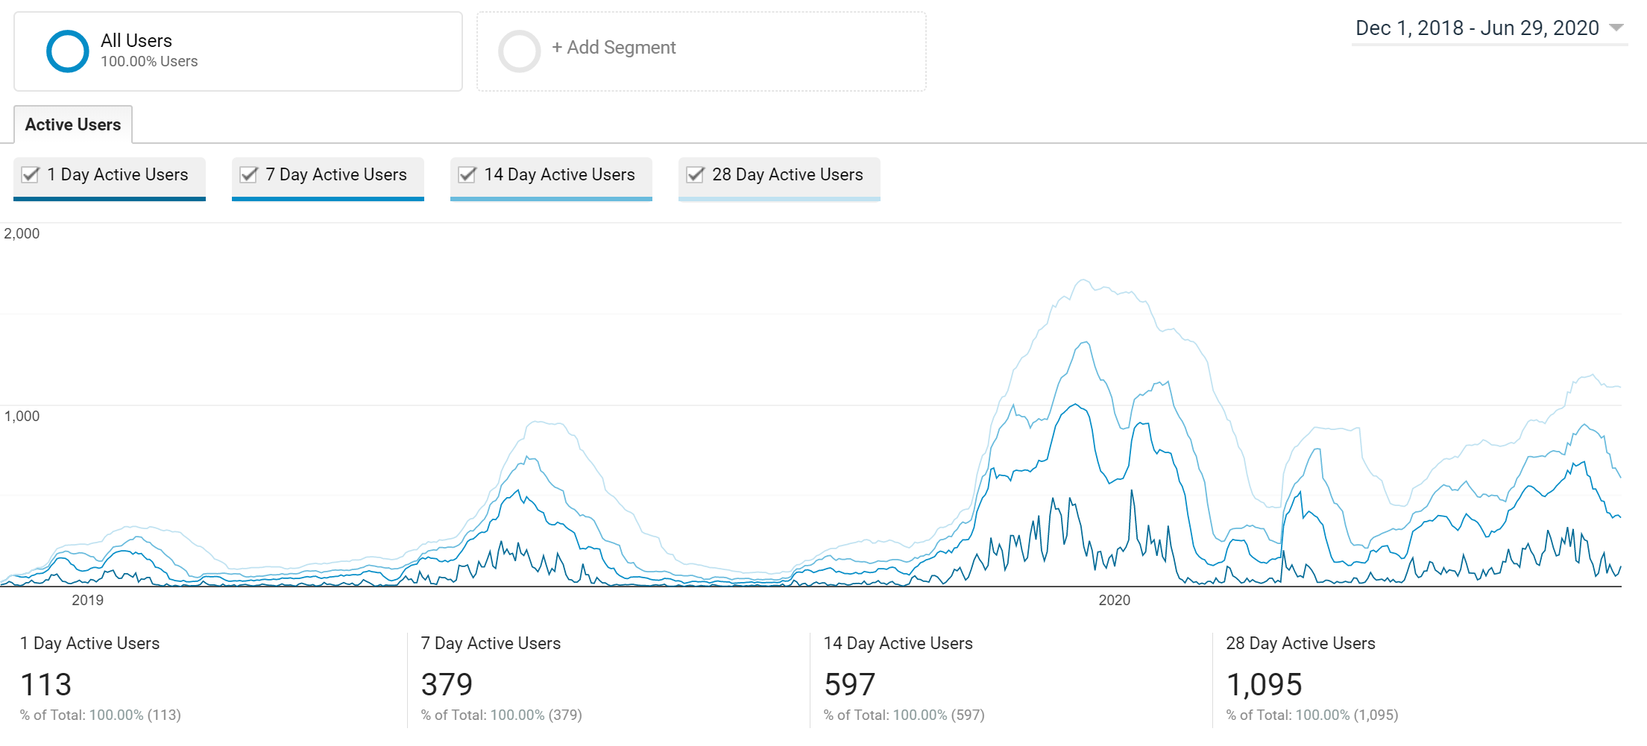
Web performance 2

Slide 33
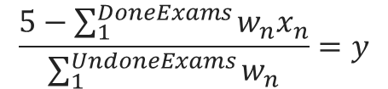
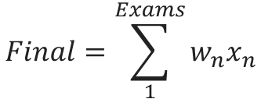
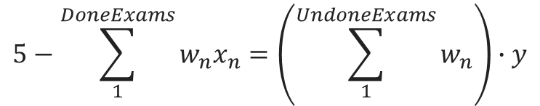
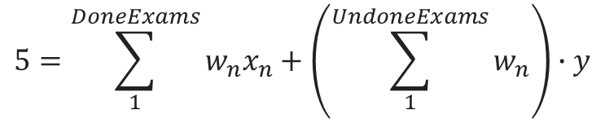
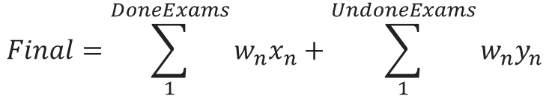
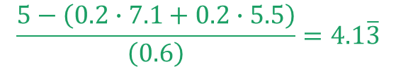
Calculate final grade
Calculate necessary grade
$$Final=\sum_{1}^{DoneExams}{w_{n}x_{n}}+\sum_{1}^{UndoneExams}{w_{n}y_{n}}$$
$Final=w_{1}x_{1}+$ $w_{2}x_{2}+…+ w_{n}x_{n}$
$$Final=\sum_{1}^{Exams}{w_{n}x_{n}}$$
$$5=\sum_{1}^{DoneExams}{w_{n}x_{n}}+\left(\sum_{1}^{UndoneExams}{w_{n}}\right)∙y$$
Example
Exam | Weight | Grade
Parcial 1 | 20% | 7.1
Parcial 2 | 20% | 5.5
Final | 60% | -
$$5−\sum_{1}^{DoneExams}{w_{n}x_{n}}=\left(\sum_{1}^{UndoneExams}{w_{n}}\right)∙y$$
$$0.2∙7.1+0.2∙5.5+0.6∙0=2.25$$
$$\frac{5−\left(0.2∙7.1+0.2∙5.5\right)}{\left(0.6\right)}=4.1\overline{3}$$
$$\frac{5−\sum_{1}^{DoneExams}{w_{n}x_{n}}}{\sum_{1}^{UndoneExams}{w_{n}}}=y$$
$$0.2∙7.1+0.2∙5.5+0.6∙4.1\overline{3}=5$$

Slide 34
Total costs
Category | Category cost | Amount | Total cost
Human resources | 5460€/month | 3months | 16380.00€
Hardware | 3890€ | 1 | 3890.00€
Software | 15€/year | 5years | 75.00€
Other | 140€/month | 3months | 420.00€
Contingencies | 586€/month | 3months | 1758.00€
Unforeseen | 3147.75€ | 1 | 31477.50€
Total |  |  | 25670.75€
Category | Category cost | Amount | Total cost
Human resources | 0€/month | 3months | 0.00€
Hardware | 0€ | 0 | 0.00€
Software | 15€/year | 1years | 15.00€
Other | 0€ | 0 | 0.00€
Contingencies | 0€ | 0 | 0.00€
Unforeseen | 25€ | 1 | 25.00€
Total |  |  | 40.00€
Calculated expenses
Payed expenses

Slide 35
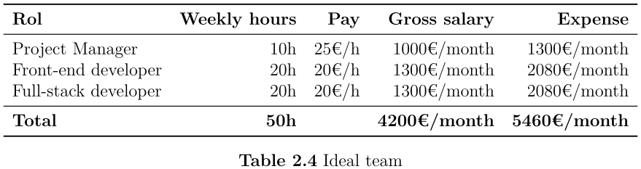
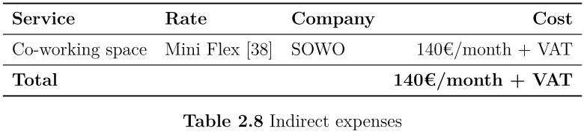
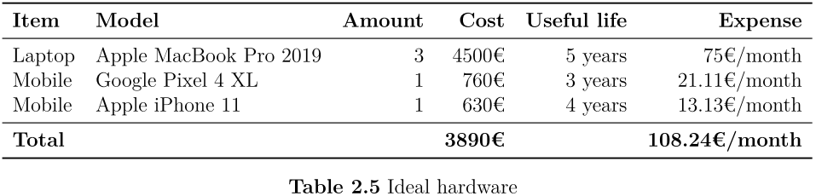
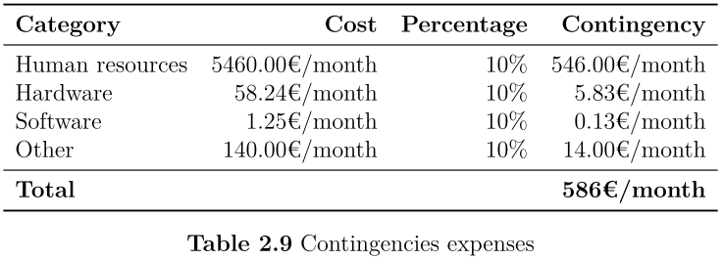
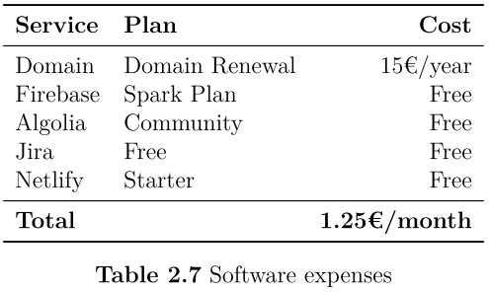
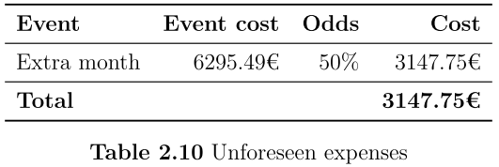
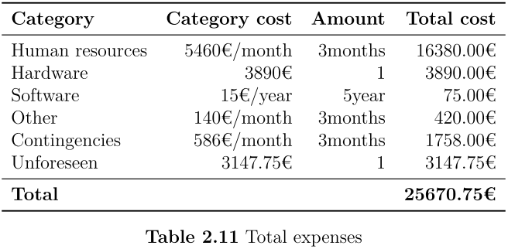
Detailed expenses

Slide 36
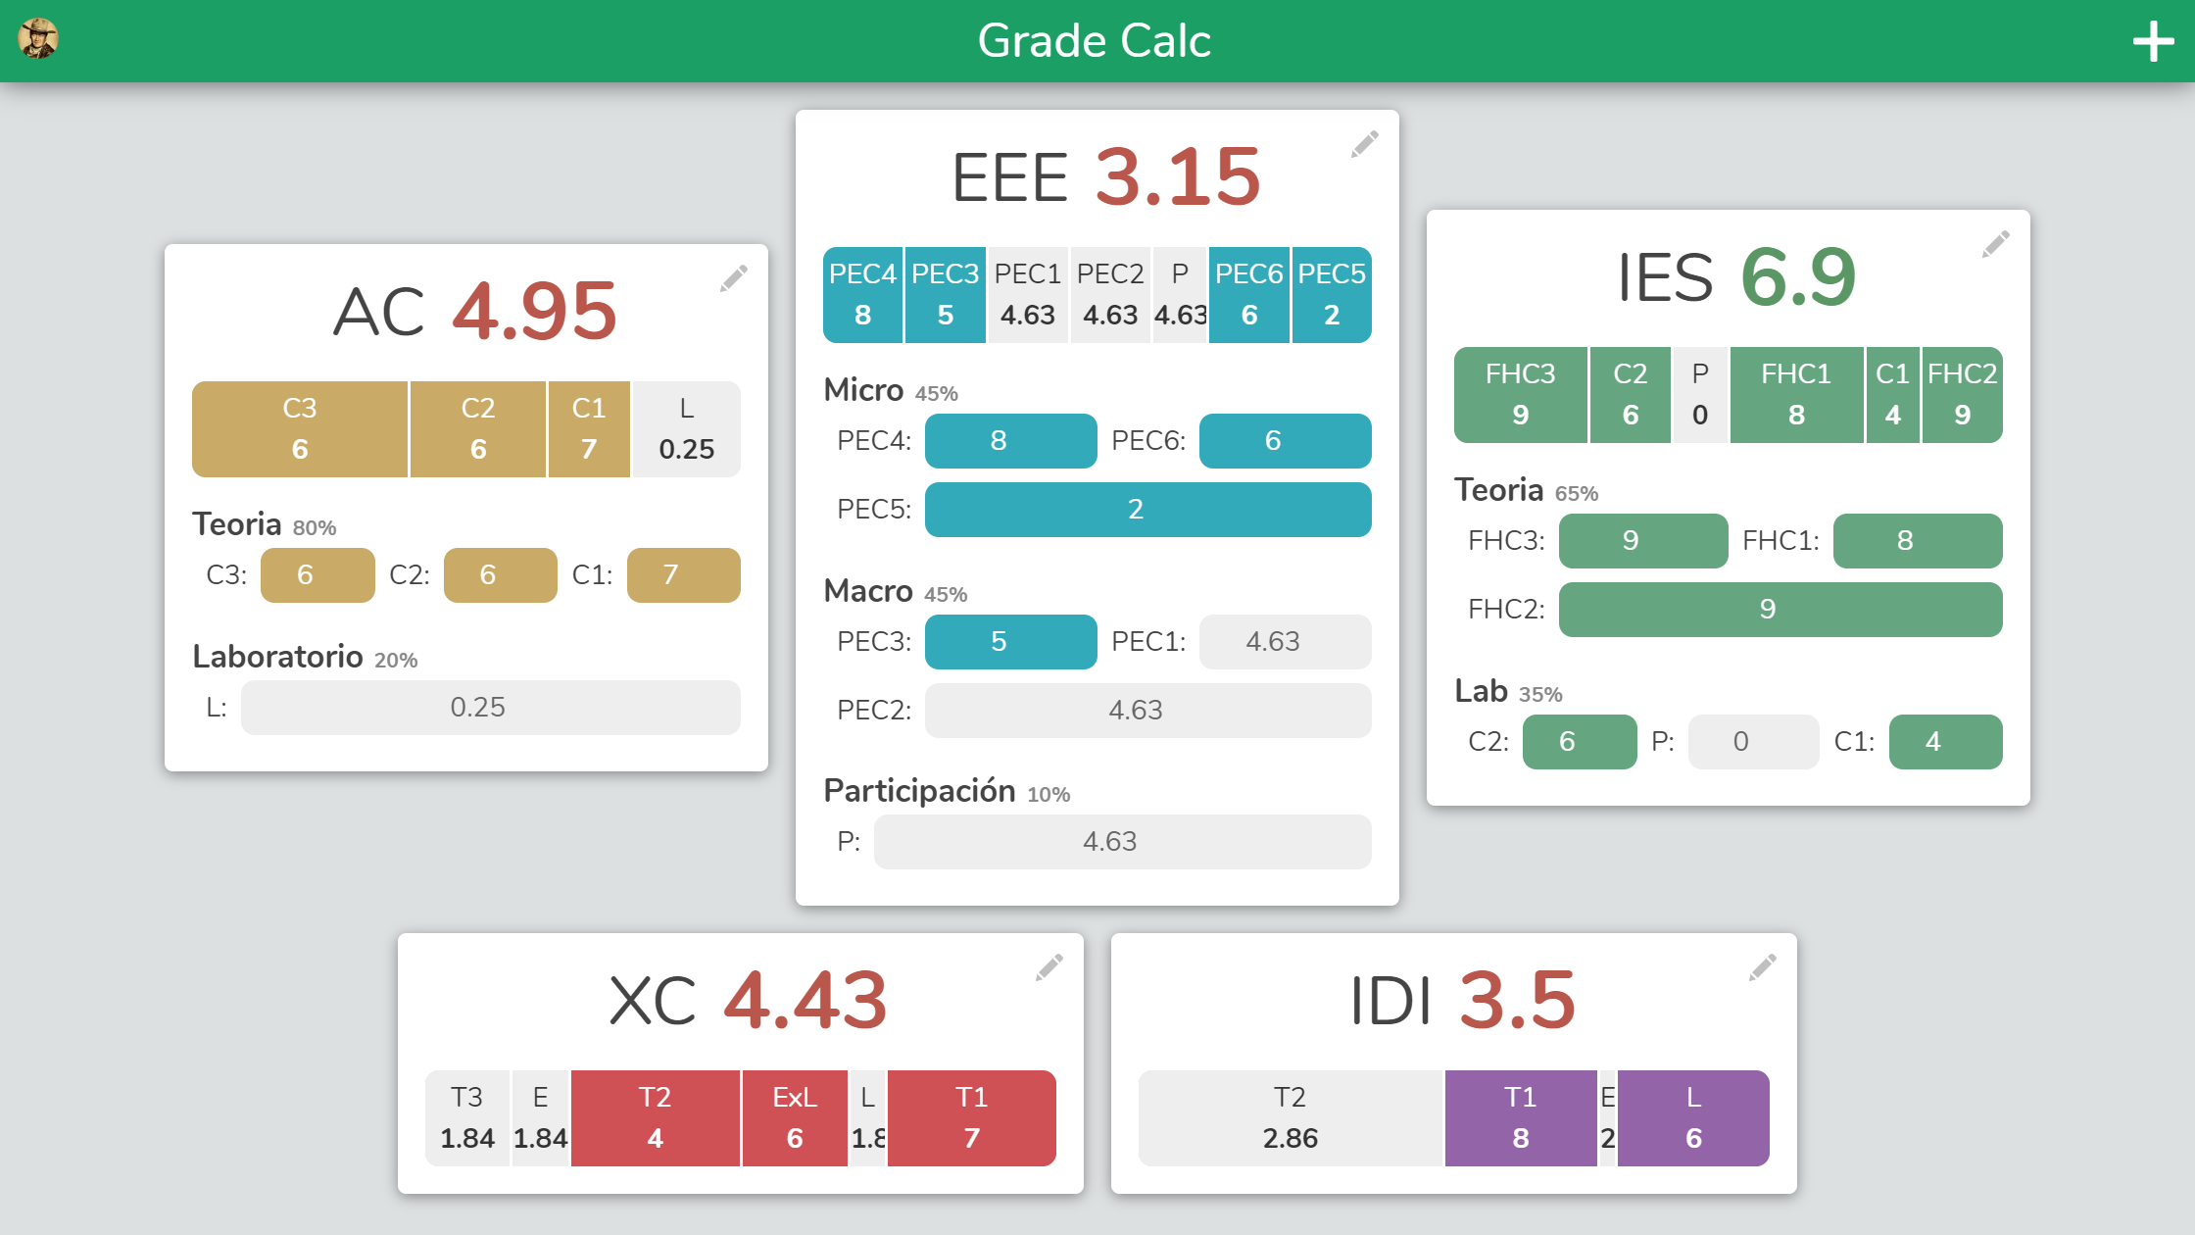
Dashboard

